Slide 1



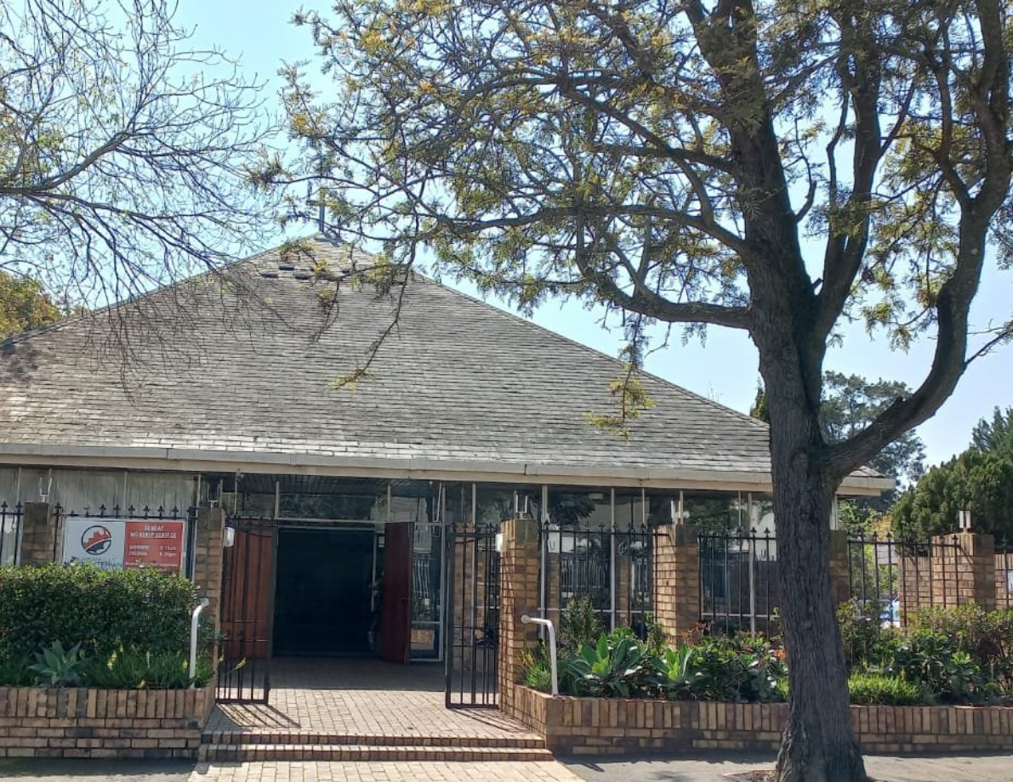



Restoring Healthy Congregational Life
Practical steps for administrative resolution
Clear procedures for addressing issues in sessions, boards, and fellowships.
Peter Langerman
Presenter

Slide 2









Administrative, not disciplinary
Aim: rectify unsatisfactory state
01
02
Nature and Purpose of Proceedings
Proceedings focus on governance and order, not punishment.
Address problems in congregation or units such as Session, boards, fellowships, choir, youth.
Administrative action to restore congregational health
Authority: Presbytery or commission
Right of review: General Assembly panel
03
04
May take appropriate administrative measures in the congregation's best interest.
Displeased parties may seek review by the General Assembly's Administrative Review Panel.

Slide 3
Any Presbytery member may raise concerns at a stated meeting
Member can bring issues about a congregation or significant group
Who May Raise Concerns and Who Oversees Them
Oversight rests with the Presbytery, not the Moderator alone
Presbytery collectively holds authority and responsibility
Moderator acts as part of the Presbytery, not independently
Moderator should follow Presbytery directions and procedures
Presbytery authority, member rights, and the Moderator’s role
Cases are handled within Presbytery boundaries following procedures
Matters stay under Presbytery jurisdiction and process

Slide 4





Required members
Representation goals
Co-option option
Moderator
Reflect Presbytery cultural diversity
Permit co-option of additional Presbytery members for a specific investigation
Clerk
Reflect Presbytery language diversity
At least two Ministers
Pastoral Team: Composition
At least two Elders
Include both genders where possible
Minimum membership, diversity goals, and co-option option

Slide 5




Pastoral Team: Initial Steps
How Moderator and Clerk respond to concerns
Receive information
Moderator or Clerk receive reports suggesting an unsatisfactory state.
Consult
Moderator and Clerk consult together and may involve the pastoral team.
Verify
If information seems reliable, gather details from complainants to assess grounds.
Notify Minister
If grounds are sufficient, notify the Minister in person when nearby.
Notify Session
Call a Session meeting to address the concern and determine next steps.

Slide 6




Consult and mediate with Minister and Session
01
Pastoral Team: Follow-up Responsibilities
Invite all parties to meet and seek resolution
Escalate if unresolved
02
Report to next ordinary Presbytery or request special meeting
Consult, escalate if necessary, and document outcomes for Presbytery
Document outcomes for Presbytery consideration
03
Record decisions and submit documentation to Presbytery

Slide 7

How the Presbytery Decides
01
Assess urgency first
02
Do nothing
03
Instruct the Moderator to act
04
Refer to the Session with assessors
Evaluate severity and prior attempts to resolve before acting
Appropriate if issue is resolved or low severity
Delegate immediate action to the Moderator
Session handles matter with possible outside assessors
05
Appoint a Presbytery commission
06
Request Synod or General Assembly committee
07
Base choice on severity and prior attempts
Commission visits and reports with defined powers
Committee may appoint commission with expanded powers
Escalate only as required by seriousness and past efforts

Slide 8




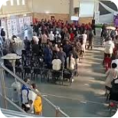
Presbytery Actions: Selective Response Options
Clear pathways for oversight, intervention, and reporting
No further action
Moderator acts via pastoral team
Take no step when the situation does not warrant intervention.
Ask the Moderator to implement options available to the pastoral team.
Refer to Congregation Session
Appoint Presbytery commission
Direct the Session to follow church law and appoint assessors if needed.
Send a commission to visit, attempt rectification, and submit a written report; include summary if unresolved.
Ask Synod or General Assembly committee
Request a committee to appoint a commission with powers defined in paras 10.55–59 (see MOFO§10.41(e)).

Slide 9






Commissions, Reporting, and Escalation
Clear duties for Presbytery, Synod, and General Assembly commissions
Presbytery appoints commissions to visit and attempt rectification
Commissions must report back in writing promptly
If unable to resolve, include a brief summary of the situation in the report
Commissions act under Presbytery authority to resolve issues promptly.
Written report required even if matter is resolved; keep concise.
Summaries should state outstanding issues and actions taken.
Synod or General Assembly committees (Moderator, Clerk, Treasurer) may appoint commissions with specified powers
Commissions appointed by Synod or General Assembly report to the appointing council
Escalation path: Presbytery to Synod to General Assembly when matters remain unresolved
Reports go to the council that made the appointment for oversight.
Escalate only when commissions cannot effect rectification.
Appointing council defines commission powers and scope.

Slide 10
Raise Concern
Presbytery decides on a range of actions to protect the congregation
Individual or group raises a concern about congregational life or ministry
Commission, Report, or Escalation
Pastoral Team Inquiry
Protecting Congregational Life: Summary of Review Process
Pastoral team conducts a focused inquiry to assess the issue
Presbytery may commission action, issue reports, or escalate matters
Notify Minister and Session
General Assembly Review Right
Minister and session are formally notified of findings and concerns
Individuals or groups dissatisfied may seek review by the General Assembly Administrative Review Panel
Linear process from concern to General Assembly review right
Mediation
Mediation offered to resolve conflicts before formal action
Presbytery Decision

